Slide 1
THE BENEFITS OF PROMOTING HEALTHY EATING AT <INSERT ORGANISATION>
<insert logo>
<insert presenter>
<Insert date>
Notes:
Use this presentation to present to your organisation’s management team about why they should support the implementation of healthy eating strategies within the organisation. This could include strategies to promote and provide healthy food and drink choices at staff meetings, functions, workshops, events your organisation runs, the sale of food and drinks to customers via fundraisers, canteens or vending machines, and/or the food and drinks provided to players, volunteers and spectators during training and on game day.
Feel free to add your own logo or transfer the content to your branding. Throughout this presentation speaker notes are in bold font. Additional information in italics is not designed to be read out.
You will need to adapt this presentation to the needs of your organisation before presenting. Feel free to add or remove content and slides to ensure it is relevant to your organisation.
Introduce yourself:
Today I’m here to talk to you about the benefits of promoting healthy eating across our business, including both internal and external functions and events. There is a strong link between sport and healthy eating. Adults who eat well enjoy more energy and vitality, making it easier to stay fit and active. Children who eat well will have energy for playing and sporting activities. Sporting organisations are in a fantastic position to lead by example and promote healthy eating to players, volunteers, spectators and the community.
I will cover:
What we mean by healthy food and drinks
Examples of sports already taking action
Why <insert organisation> should promote healthy eating
What is a nudge?
Recommendations for creating a supportive, healthy environment in our sport
Additional support & resources

Slide 2
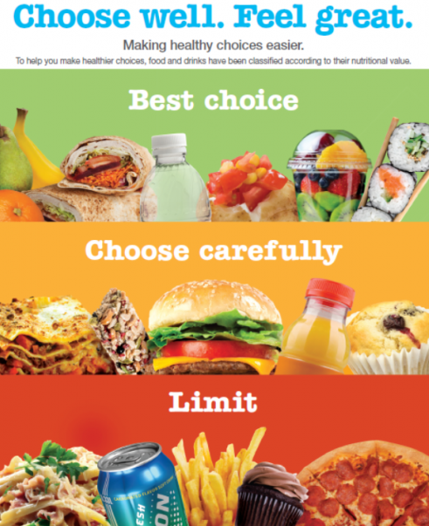
<insert logo>
Notes:
Presenter notes:
In addition to the information on the slide, you could provide some examples of food and drinks from each category.
Green – Bread, high fibre breakfast cereals, reduced fat milk, cheese and yoghurt, lean meat, fish, eggs, plain nuts and seeds, tofu, fruit (fresh, frozen), vegetables
Amber - Some savoury breads and crackers, some wholemeal muffins or scones with added fruit and vegetables, dried fruit, fish canned in brine or oil, salted nuts and seeds, some oven baked potato products, regular fat milk, cheese, yoghurt and custard, some flavoured milk, 99% fruit juice, artificially sweetened drinks
Red - Sugary drinks (e.g. soft drinks, sports drinks), confectionery, ice creams and dairy desserts, biscuits, cakes, slices and sweet pastries, saturated fats and oils (e.g. butter, cream), deep fried foods, crisps and chips, pies, sausage rolls, Devon, salami, Strasburg, sausages, Savoys
You can also use the Healthy Choices website from the state government as a guide: http://heas.health.vic.gov.au/healthy-choices/guidelines/traffic-light-system
HEAS (the Healthy Eating Advisory Service) has a large variety of useful resources including a mentorship program, online product checker (FoodChecker) and menu assessment templates.
To start off, let’s talk about what we mean by ‘healthy eating’.
The Victorian State Government’s ‘Healthy Choices’ is a framework for improving the availability and promotion of healthier foods and drinks in community settings..
To help understand what ‘healthy’ choices are, these guidelines use a traffic light approach to classify foods and drinks into:
GREEN = Best choice - food and drinks in this category are high in fiber and energy, lower in saturated fat, added sugar and/or salt and a good source of nutrients.
AMBER = Choose carefully - food and drinks in this category contain saturated fat, added sugar and/or salt and should only be eaten in moderation.
RED = Limit intake - food and drinks in this category are high in energy, saturated fats, sugar and/or salt. If they are consumed too often, or in large amounts, they can lead to weight gain and chronic diseases.
Guidelines are available to support the implementation of Healthy Choices in numerous settings, including sport & recreation centres.
These guidelines address the provision of GREEN, AMBER and RED foods and drinks through retail outlets, vending machines and catering, as well as how food and drinks are promoted and displayed, used for fundraising and as prizes, sponsorship by food industry, and how the physical environment can support healthy eating.
In practice, a canteen, for example, following the guidelines, would actively promote GREEN products over RED products, and GREEN foods and drinks would make up 50% of the offerings, AMBER 30%, whilst RED products would only make up 20%.

Slide 3
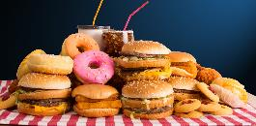
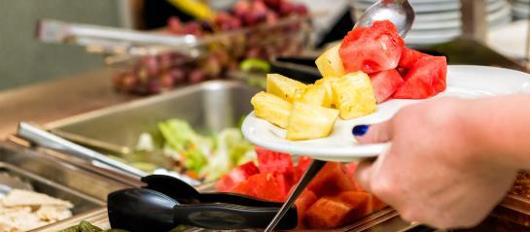
Healthy eating
<insert logo>
Why is it important?
Around half of Victorian adults are overweight or obese.
Only 5% of adults and children are eating the recommended daily amount of fruit and vegetables
47% of children consume sugar sweetened beverages daily
Notes:
Presenter notes:
These statistics are drawn from the VicHealth Evaluation Summary ‘Healthy food and drink choices in community sport’ available at https://www.vichealth.vic.gov.au/media-and-resources/publications/healthy-choice-food.
Healthy eating and good nutrition helps us to get the most out of life and at all stages of life. Adults who eat well enjoy more energy and vitality, making it easier to stay fit, active and happy. Children who eat well will have energy for physical activity and sport and are more likely to maintain healthy eating habits as adults. Healthy eating also helps them to concentrate and learn, and supports normal growth and development.
On the flip side, an unhealthy diet puts us at risk of becoming overweight and obese, and developing weight-related diseases, such as type 2 diabetes, cardiovascular disease and some cancers.
Healthy eating, enjoying mostly food and drinks from the GREEN category has many benefits for both adults and children, including:
Energy and vitality to stay fit and active
Better recovery and reduced chances of injury
Concentration and learning
Growth and development (for children)
Maintaining a healthy body weight
Whereas, food and drinks in the RED category, which are high in salt, fat and sugar (including sugar sweetened beverages like soft drinks) and low in fiber, are low in essential nutrients and often high in energy (calories / kilojoules), and can lead to weight gain and increased risk of chronic disease.

Slide 4
Healthy eating
<insert logo>
Who else is doing it?
Public settings and organisations across Victoria have already made the change to promote and provide healthier food and drink choices
Settings include: Early learning centres, schools, hospitals, universities, workplaces and sport & recreation centres
Three (3) in four (4) people want access to healthier food and drinks in Victorian sporting venues.
<insert link to a relevant case study >
Notes:
Presenter notes:
Its important to note here that Healthy Choices are being implemented across multiple community settings in Victoria, and the momentum is growing – the time to act is now.
The statistic listed on the slide is from the VicHealth 2016 Community Attitudes Survey.
It would add value to your message by finding a relevant case study from a sport setting, where others have successfully been implementing change towards the promotion of healthier food and drinks, without impacting profits.
You can find sport relevant case studies here:
VicHealth: AFL Victoria, Netball Victoria, Basketball Victoria, Football Victoria / Glen Eira Football Club , Ballarat Aquatic and Lifestyle Centre, Gippsland Regional Sports Complex, Geelong Central Netball Club, YMCA Victoria
Go to https://www.vichealth.vic.gov.au/media-and-resources/publications/healthy-choice-food
HEAS: Melbourne Sports and Aquatic Centre, YMCA Victoria, City of Melbourne, Western Leisure Services
Go to http://heas.health.vic.gov.au/healthy-choices/case-studies
Many organisations across Victoria have begun offering healthier food and drinks in their settings by implementing the Healthy Choices guidelines.
Early learning centres, schools, universities, hospitals ,workplaces and sport settings are all getting on board as they realise the important part they can play in community health AND that this is what their community and their customers want. No one wants to get left behind.
This includes sporting organisations.
Research tells us that three in four people want access to healthier food and drinks in Victorian sporting venues.
In addition, VicHealth evaluation results indicate that making changes in sport settings, such as decreasing the availability of sugary drinks and promoting the sale of water and healthier drinks, can shift consumption to healthier options without jeopardising profits. Many organisations have shown this to be true and have already made the changes.
<Discuss a sport example / case study that is relevant to your sporting organisation>

Slide 5
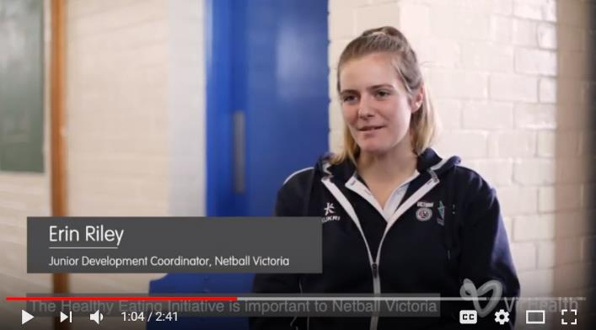
Healthy eating
<insert logo>
WHY US?
<Insert organisation> will demonstrate leadership by promoting healthy eating for staff, volunteers, coaches, participants, officials and family members.
“Introducing healthy food into our NetSetGo program not only allows the participants to take on the healthy food habits, but also ensures they have enough energy to play at their best” – Netball Victoria (2017)
Notes:
Presenter notes:
There are many benefits to making sporting environments more healthy including attracting new members, retaining existing members, obtaining better funding and sponsorship opportunities and raising the organisation profile in the community.
Quote taken from Netball Victoria case study video available at: https://www.youtube.com/watch?v=umf3xpPKIV8&feature=youtu.be
There are many benefits to creating healthy sporting environments, including:
Attracting and retaining members
Funding and sponsorship opportunities
Participants are healthier and play for longer
Creating a family-friendly environment that encourages health and community participation
Sharing positive messages about healthy eating and active lifestyles
It makes sense - with sport being the largest community sector in Victoria, sporting organisations are in the ideal position to lead by example in promoting healthier lifestyles, and support the connection between sport and healthy food and drink choices to their players, volunteers, spectators and patrons.
In addition to health and growth, we know the healthy eating is vital to good sport performance.

Slide 6
Healthy eating
<insert logo>
Our current situation looks like…
Optional: insert a summary of your organisation’s current situation. This could include:
relevant policies (e.g. Responsible Service of alcohol) or strategies used (e.g. food vouchers as rewards)
evidence of red (e.g. lollies / chips / soft drinks), amber (e.g. artificially sweetened soft drink) or green (water / fruit) food and drinks at events or in your canteen
evidence of demand for healthy choices from members, staff, volunteers or other key stakeholders
Strategies adopted by other sports organisations similar to yours
Notes:
Presenter notes:
Why should your organisation make a change?
You can use this slide to add relevant information about your organisation or community with regards to the promotion of / sale of / provision of / sponsorship of unhealthy food and drink options. This is your opportunity to highlight the things your organisation could be doing better to promote the health of its community.
(Delete the slide if it doesn’t apply)
You could conduct a survey of staff or your members using Survey Monkey, or speak to a selection of people one on one, or in a group, to understand their views of a healthy eating policy.
Take a photo or do a count of the status quo with regards to food provision or retail in your organisation (e.g. catering at events, canteen food and drink options etc) – what products and offerings do you currently serve or sell? You can use the Healthy Eating Advisory Service (HEAS) FoodChecker resource (http://foodchecker.heas.health.vic.gov.au/ ) to assess your current offerings/products against the Healthy Choices guidelines.
You could also look into:
Any data or evidence from your HR team about rates of staff or volunteer absenteeism due to sick leave, personal leave, or other
Look at data from the Victorian Population Health Survey - https://www2.health.vic.gov.au/public-health/population-health-systems/health-status-of-victorians/survey-data-and-reports/victorian-population-health-survey. Click the snapshot Report 1 (Modifiable risk factors contributing to chronic disease) to find obesity rates, sugar-sweetened beverage consumption and fruit & veg consumption rate by local government area.
Policies or other relevant strategies used in sporting organisations similar to yours or that you consider as aspirational (e.g. Melbourne Sports & Aquatic Centre, YMCA Victoria, AFL Victoria’s coach training or Netball Victoria’s junior snack program) see Victorian examples here https://www.vichealth.vic.gov.au/easychoice and here http://heas.health.vic.gov.au/healthy-choices/case-studies

Slide 7
Healthy eating
<insert logo>
Strategies
Ways we can support our sport’s workforce and participants to eat healthy.
Educating staff / coaches / players about healthy food and drinks, including the benefits to them.
Offering healthy catering options at meetings, events and workshops across our organisation.
Offering healthier snack and hydration alternatives before, during or after events or training sessions
Increasing the visibility and promotion of water over sugary drinks
<Refer to the presenter notes below for alternative strategies relevant to your organisation>
Notes:
Presenter notes:
How does your organisation’s current situation, with regards to the provision and promotion of food and drinks, align with the your organisation’s goals, values and recognition of the connection between sport and healthy eating? Does something need to change?
There are many strategies your organisation can use to provide healthier food and drink options for your sport’s workforce, participants and community.
Highlight the fact that strategies to promote healthy eating should be supported by the organisation’s leaders with buy-in and support from all staff and volunteers.
You should tailor the strategies to suit your goals. Think about some of the following:
Does your organisation manage a facility which retails food and drink?
Does your organisation conduct events and functions (such as coaching accreditation courses)?
Do staff / players / parents of junior players want healthier options in the your organisation’s settings?
Do you have programs you could use to encourage and promote healthy eating?
Do you provide food or drink to participants before, during or after events?
Do you currently use unhealthy food or drinks as reward, for fundraising or as vouchers?
If you operate a canteen / venue or provide food, some of the small changes you could put into place immediately could include:
Increasing the visibility and promotion of water over sugary (Red) drinks.
Reducing or eliminate added salt to freshly prepared foods.
Reducing serving sizes of Amber and Red foods.
Replace white rolls/bread with wholemeal or multigrain rolls/bread.
Introduce salad rolls or ensure more salad rolls are always available.
Switch to steamed over fried foods.
Replace full fat milk with low fat milk for tea and coffee.
Provide fruit for sale.
Introduce salt-reduced versions of food and condiments.
Remove pies, pasties and sausage rolls from the menu.
Review portion or serving sizes.
If you are interested in implementing healthier catering options, consider the following ideas from the healthy eating advisory service: https://heas.health.vic.gov.au/food-outlets-caterers-vending/food-and-drink-ideas/healthier-catering
Considering our current situation, and thinking about how we could align this more with our <goals / values etc>, there are some strategies we could use to start encouraging our community, workforce and participants to eat and drink healthier – making the healthy choice, the easy choice.
(Read out list of chosen strategies and discuss with your audience)

Slide 8
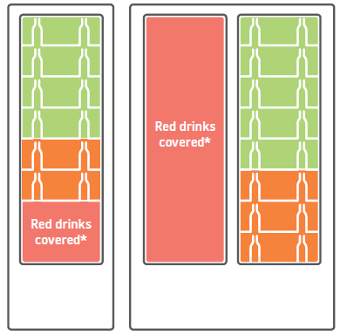
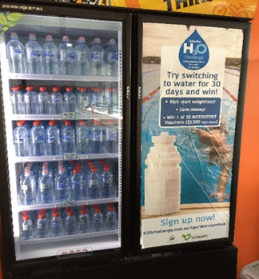
Healthy eating
<insert logo>
What is a nudge?
Notes:
Presenter notes:
Introducing changes that make the healthier choice the easier choice in sport settings can start with a small change such as introducing a nudge to influence what people are choosing to purchase or consume.
After trialling 4 different types of drinks nudges in 80 different sport settings across Victoria, VicHealth found that two nudges were the most successful: ‘red drinks off display’ where red drinks are hidden behind fridge decals or posters on one side of a double fridge or put in the lower half of a single fridge with no promotion of red drinks, e.g. on menu boards, and ‘limit red drinks’ where less than 20 per cent of the fridge is stocked red drinks, while green drinks are displayed at eye level. (See VicHealth’s ‘Healthy food and drink choices in community sport’ report for further details, here http://vichealth.vic.gov.au/easychoice)
Think of possible ways you could introduce nudges in your organisation’s environment and add them to this discussion.
Obviously, we don’t have to change everything at once.
One of the ways many sport and recreation organisations, and other settings, have been going about making healthy choices the easy choice, is by introducing behavioural nudges.
What’s a nudge you might ask?
A ‘nudge’ is a small change that might influence people’s behaviour without forbidding any options. For example, displaying water for sale at eye level within a canteen and limiting the promotion of sugar sweetened beverages (SSBs) or sugary drinks by putting them out of sight, such as under a counter, is a nudge, whereas banning SSBs from a canteen or a venue completely is not considered a nudge (although it is still a valid option for some settings where there is support for this).
Nudges such as ‘red drinks off display’ (as seen in the fridge planogram example on this slide, where ‘red’ drinks are kept out-of-sight) or ‘limit red drinks’ (where ‘green’ drinks take up more than 50% of the fridge space, and ‘red’ drinks only 20%) in canteen fridges have been seen to be effective strategies to use in sport settings, shifting consumption to healthier options without jeopardising profits.
For meetings, events and functions, a ‘nudge’ could mean providing majority Green food and drink options and limiting Amber and Red options.

Slide 9
Healthy eating
<insert logo>
Recommendations
<Insert organisation> could start with some of the following steps:
<Insert strategies as relevant to your organisation (see presenter notes for information and advice)>
Notes:
Presenter notes:
Use this slide to outline your plan - what are the steps you suggest the organisations takes?
The key outcome is that management / board members support the trialling of all healthy choices strategies.
Making small changes, and seeking feedback from staff and volunteers, is a great way to start the process. The ultimate goal might be to implement a policy which embeds a culture of healthy eating across the organisation.
You could consider one of the following as starting point:
Trialing the implementation of healthy choices guidelines for all internal and external meetings, functions and events. This would mean providing majority GREEN options, with a limited number AMBER and minimal or zero RED options.
Limiting the availability of AMBER or RED choices in the office and at venues your organisation manages.
Implementing a healthy eating policy for your organisation (see separate slide pack on Vicsport website).
Supporting staff to be champions of healthy eating and develop a culture of healthy eating in our organisation.
Here's some easy steps you can take at your sporting organisation to help more people choose healthier food and drink options:
Step 1 – Plan your approach
Step 2 – Gain support
Step 3 – Play to your strengths
Step 4 – Involve and educate key influencers
Step 5 – Make a healthy change
Step 6 – Evaluate
Step 7 – Embed the healthy change
To find out more see ‘Healthy food and drink choices in community sport’. This report summarises some of the evaluation results from VicHealth’s healthy food and drink nudge work with sports, and discusses the key learnings, including Steps 1-7 mentioned here.

Slide 10
Healthy eating
<insert logo>
Resources
The following resources are available to help <insert organisation> implement healthy eating strategies:
Vicsport – Healthy Sport website – includes useful tips, resources and case studies.
VicHealth – Healthy choice: the easy choice – includes case studies from sports who have implemented healthier food and drink choices in their settings.
Healthy Eating Advisory Service – includes information about healthy food and drink options, resources and advice.
Notes:
Presenter notes:
If desired, don’t present this slide but use the links and resources to support your presentation. You can share the slides with management and/or board members so that they can view the resources available.
There are many useful resources available to support us to create a Healthy Choices policy.
The Vicsport Healthy Sport website includes useful resources, tips and templates to assist us to implement healthy eating policies.
VicHealth’s website includes case studies, tips and resources to support the business case for healthy eating strategies.
HEAS, the Healthy Eating Advisory Service, has some easily accessible resources to find healthier products for all situations (including catering, sport and recreation facilities, club canteens, fundraising and much more), case studies and great tips on the implementation of Healthy Choices into sport and recreation settings – including guidance on developing policies, working with food service providers and suppliers, educating staff and other stakeholders, and working with on- and off-site retail outlets.
One of the most frequently asked questions when organisations start implementing changes is, “Where do we get the healthier food and drinks from?”. Calling HEAS is the best place to start.

